Slide 1
Employee Attrition analysis
BY:- ABHI SAHU

Slide 2
Problem Statement
XYZ company which was established a few years back is facing around a 15% attrition rate for a couple of years. And it's majorly affecting the company in many aspects.

Slide 3
Details of Data
Data of around 4000 Employee was taken for Analysis.
Table contain around 30 columns of different data set Ex. Employee ID, Age, Attrition, Education Field, Employee Count, Gender, Monthly Income, Years At Company etc.

Slide 4
Main KPIs
Attrition value
Attrition Rate
Job Satisfaction score
Years at Company
Departments
Tools Used for Analysis are – Excel and Tableau
LINK Tableau Public:- https://public.tableau.com/views/attritionmyme/HrAnalysticsDashboard?:language=en-US&:sid=&:display_count=n&:origin=viz_share_link

Slide 5
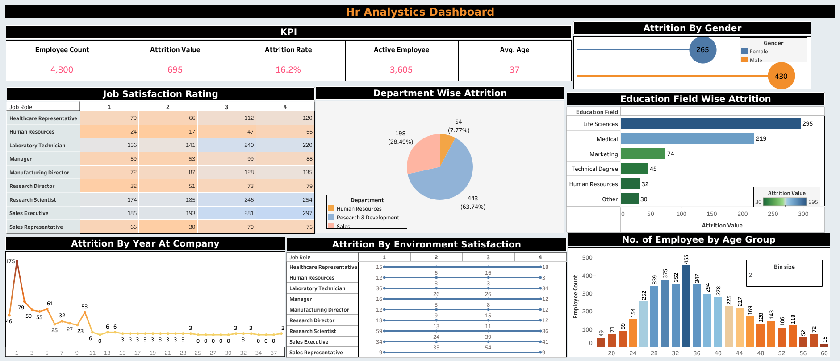
My Design

Slide 6
Thank You

